Slide 1
MERGE VS JOIN

Slide 2
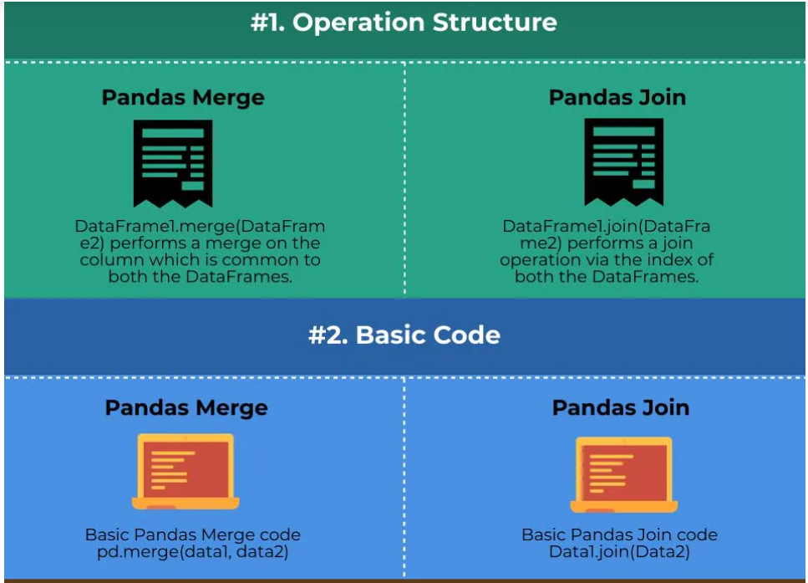

Slide 3
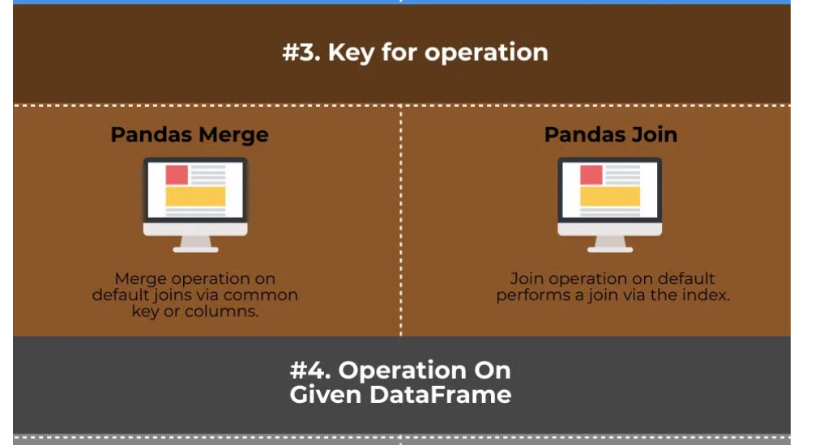

Slide 4
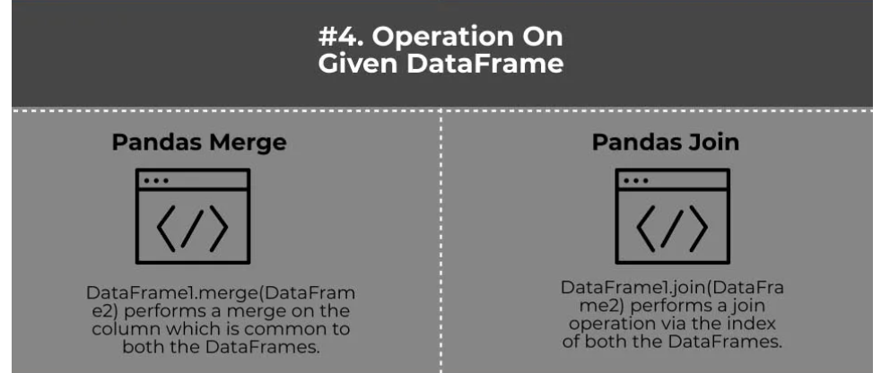

Slide 5
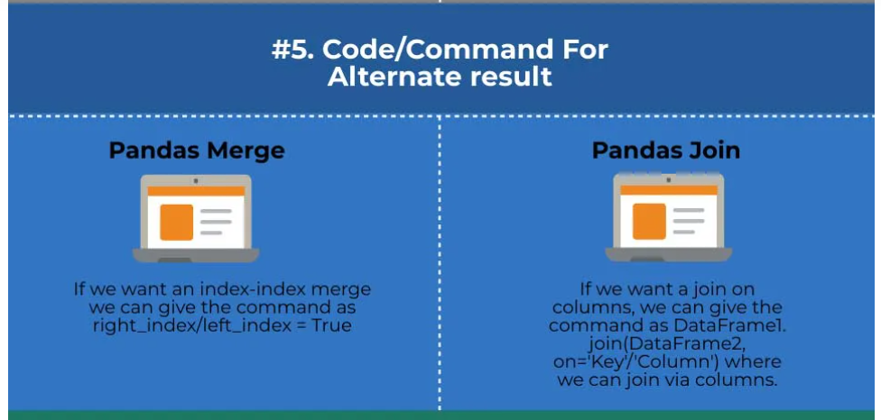

Slide 6
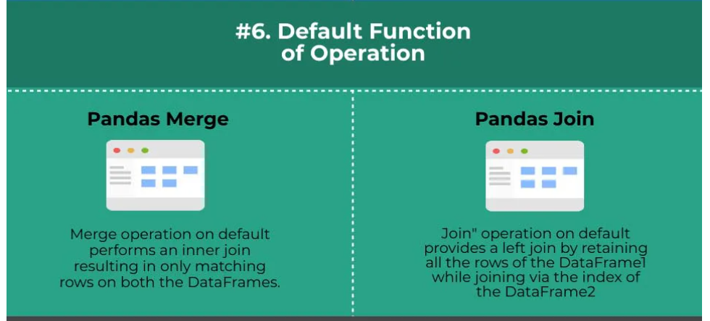

Slide 7
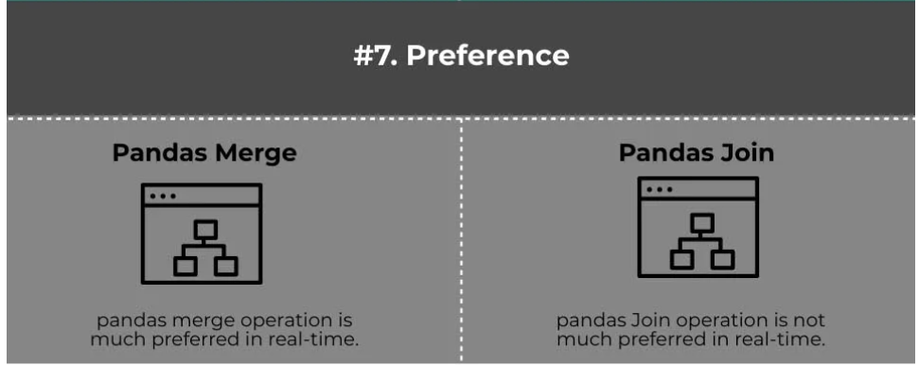

Slide 8
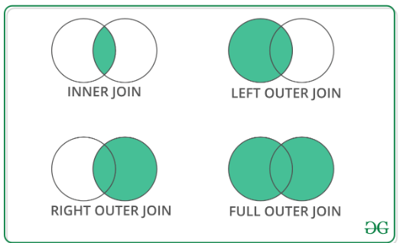
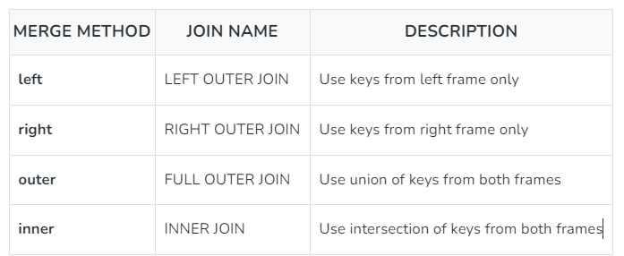

Slide 9
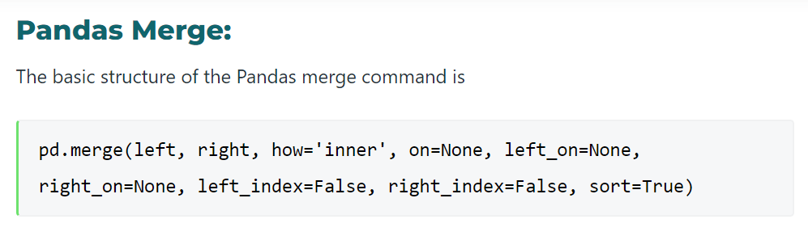

Slide 10
raw_data_1 = { subject_id': ['1', '2', '3', '4', '5'], 'first_name': ['Alex', 'Amy', 'Allen', 'Alice', 'Ayoung'], 'last_name': ['Anderson', 'Ackerman', 'Ali', 'Aoni', 'Atiches’]}
Data1=pd.DataFrame(raw_data_1)
raw_data_2 = { 'subject_id': ['4', '5', '6', '7', '8'], 'first_name': ['Billy', 'Brian', 'Bran', 'Bryce', 'Betty'], 'last_name': ['Bonder', 'Black', 'Balwner', 'Brice', 'Btisan']} Data2=pd.DataFrame(raw_data_2)
raw_data_3 = { 'subject_id': ['1', '2', '3', '4', '5', '7', '8', '9', '10', '11'], 'test_id': [51, 15, 15, 61, 16, 14, 15, 1, 61, 16]} Data3=pd.DataFrame(raw_data_3)

Slide 11
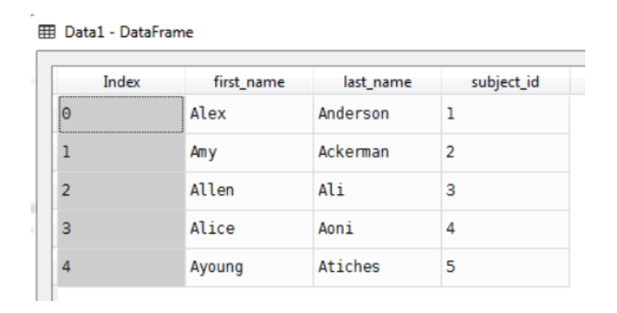
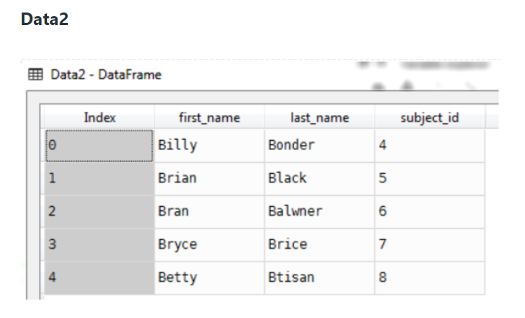
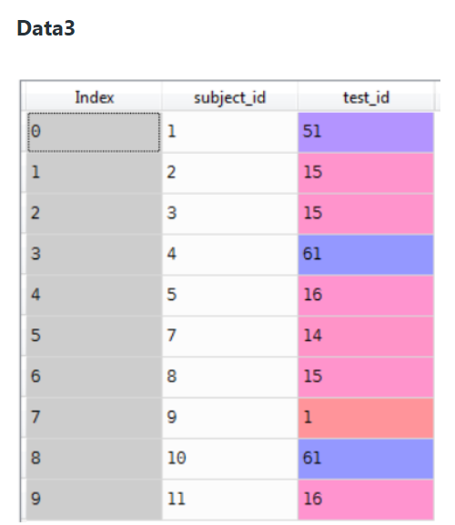

Slide 12
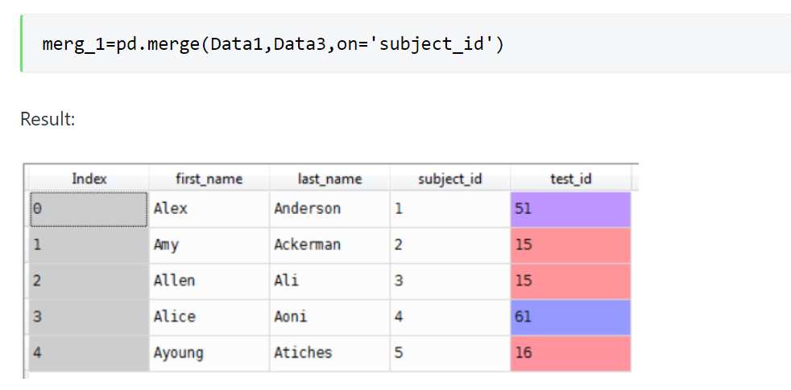

Slide 13
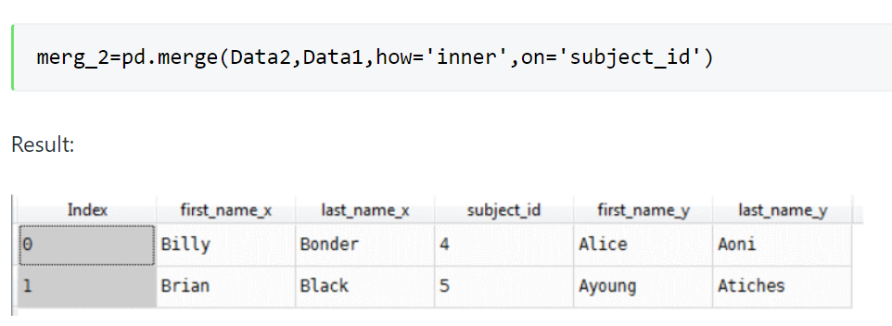

Slide 14
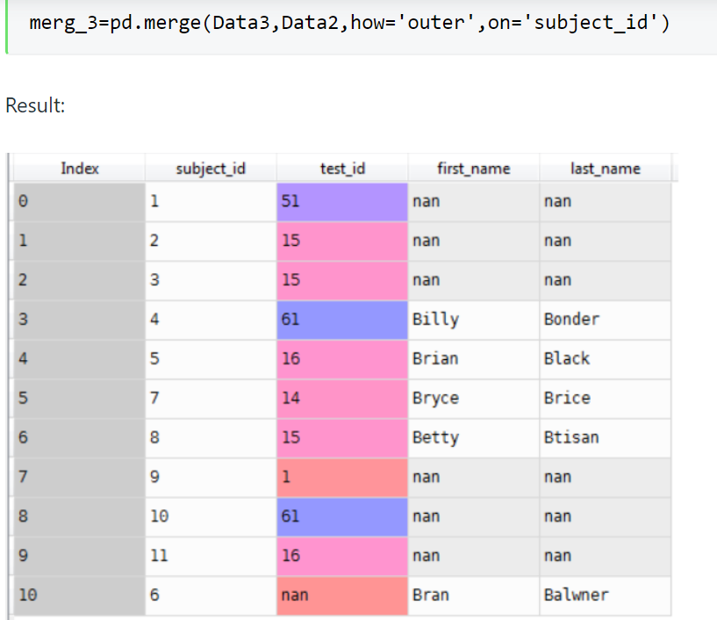

Slide 15
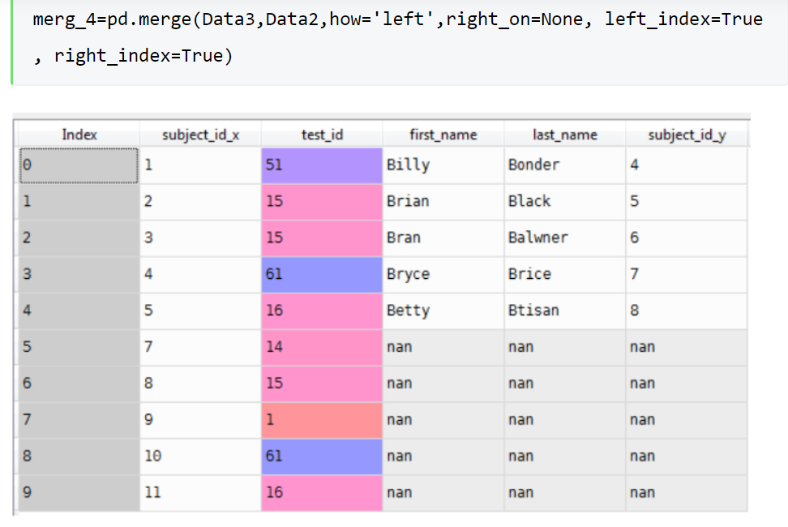

Slide 16
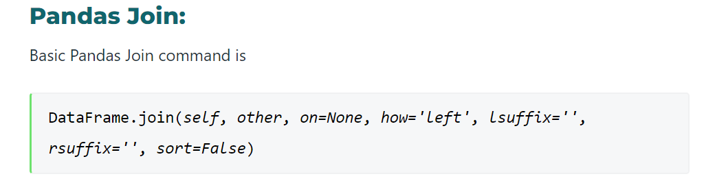

Slide 17
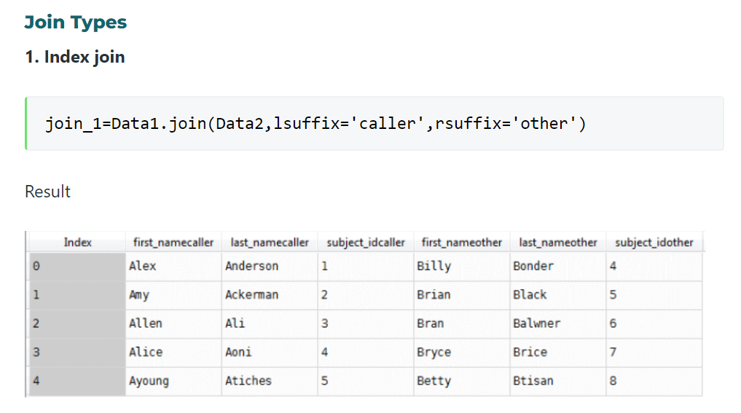

Slide 18
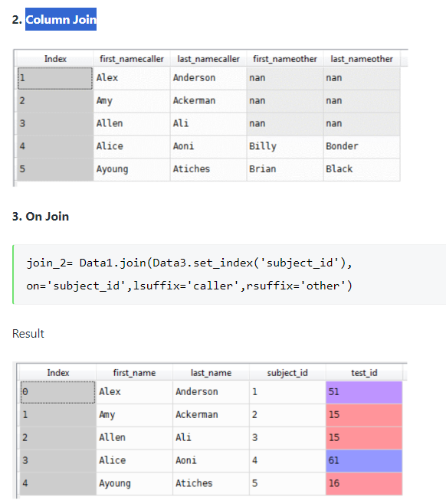

Slide 19
Example
import pandas as pd
Data1={'productid':[100,200,300,400,500],
'productname':['Amul Ghee','Pepsi','Real Juice','Dawat Rice','Dove Shampoo'],
'rate':[700,20,120,700,300],
'offer':[600,18,110,300,100],
}
Date2={'productid':[200,500,200,100,400,200,0],
'qtysale':[3,7,2,1,10,8,0]}
Data3={'productid':[600,700],
'productname':['Amul Butter','Parle G'],
'rate':[700,20],
'offer':[300,18],
}

Slide 20
Example MERGE
product=pd.DataFrame(Data1)
sales=pd.DataFrame(Date2)
product2=pd.DataFrame(Data3)
#result=pd.merge(product[['productid','rate']],sales[['productid','qtysale']])
#result=pd.merge(product,sales)
#result=pd.merge(product,sales,on='productid')
#result=pd.merge(left=product,right=sales,)
#result=pd.merge(product,sales,left_on='productid',right_on='pid')
#result=pd.merge(product,sales,how='outer')
#result=pd.merge(product,sales,left_index=True,right_index=True)
#result=pd.merge(product,sales,indicator=True)
#result=pd.merge(product,sales,how='outer',indicator=True)
#result=product.append(product2,ignore_index=True)
result=pd.concat([product,product2],ignore_index=True)
print(result)

Slide 21
Example Joins
#result=product.join(product2,lsuffix="-P1",rsuffix="-P2")
#print(result)
A=product.set_index('productid')
B=product2.set_index('productid')
result=A.join(B,on='productid',lsuffix="-P1",rsuffix="-P2")
print(result)

Slide 22
Example
merg_1=pd.merge(Data1,Data2)
print('zzzzz')
print(merg_1)
merg_2=pd.merge(Data1,Data3,on='subject_id')
print('yyyyy')
print(merg_2)
merg_4=pd.merge(Data3,Data2[['first_name']],how='left',indicator=True,right_on=None, left_index=True, right_index=True)
print(merg_4)
jn=Data1.join(Data2,lsuffix='caller',rsuffix='other')
print(jn)
D1=Data1.set_index('subject_id')

Slide 23
join_2= D1.join(Data2.set_index('subject_id'),how="inner", on='subject_id',lsuffix='caller',rsuffix='other')
print(join_2)
D=Data1.append(Data2)
print(D)
D=pd.concat([Data1,Data2])
print(D)
D=Data1.append(Data2,ignore_index=True)
print(D)
res3 = pd.merge(Data1, Data2, how='inner', on=['first_name', 'last_name'])
print(res3)

Slide 24
Crosstab
Cross tabulation (or crosstab) is an important tool for analyzing two categorical variables in a dataset. It provides a tabular summary of the frequency distribution of two variables, allowing us to see the relationship between them and identify any patterns or trends.
Syntax
pd.crosstab(index, columns, values=None, rownames=None, colnames=None, aggfunc=None, margins=False, margins_name='All', dropna=True, normalize=False)

Slide 25
Creating a Simple Crosstab Table
import pandas as pd # create a sample dataset df = pd.DataFrame({ 'gender': ['male', 'male', 'female', 'female', 'male', 'female', 'male', 'female'], 'education_level': ['high school', 'college', 'college', 'graduate', 'high school', 'graduate', 'college', 'graduate'], 'score': [75, 82, 88, 95, 69, 92, 78, 85] }) # create a crosstab table of gender and education level ct = pd.crosstab(df['gender'], df['education_level']) print(ct)

Slide 26
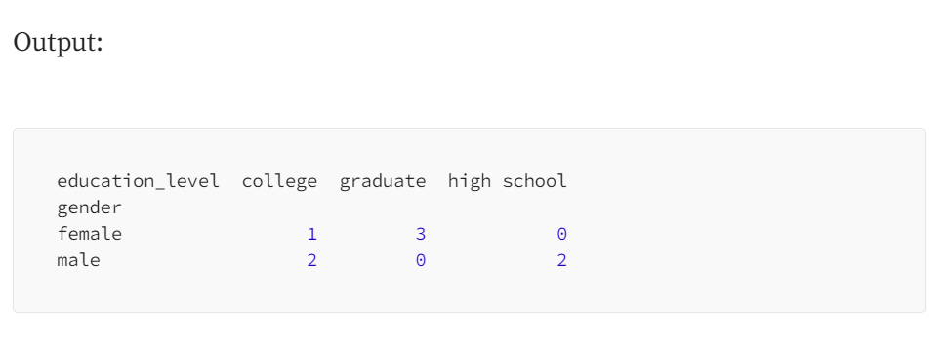

Slide 27
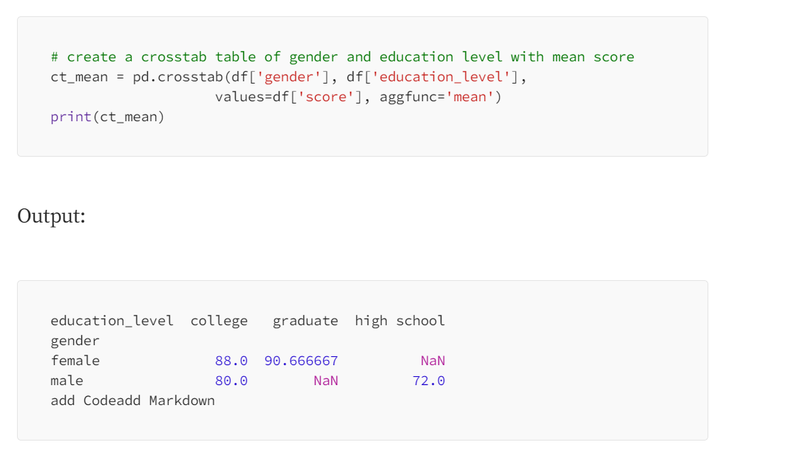
Aggregating Values in Crosstab Table

Slide 28
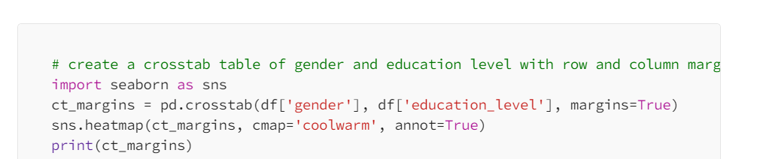
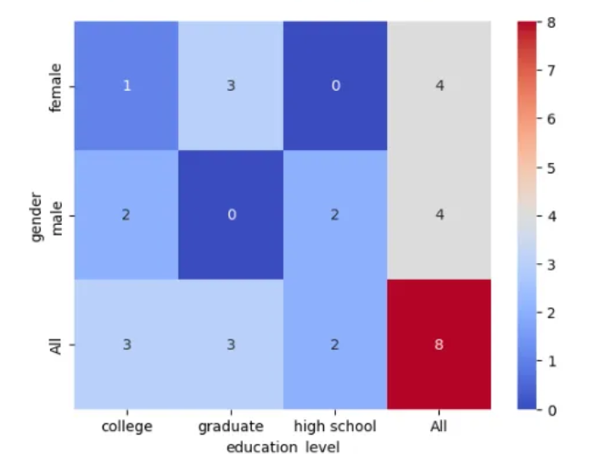
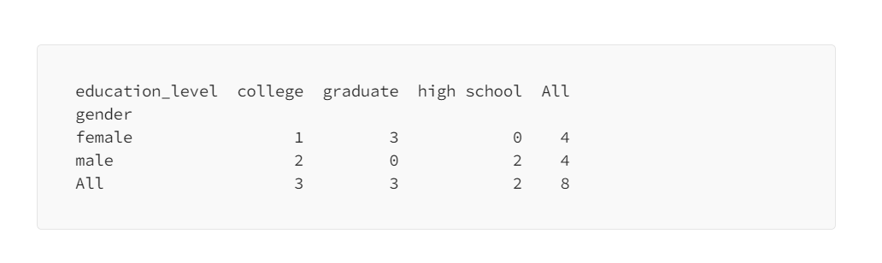
Adding Row and Column Margins

Slide 29
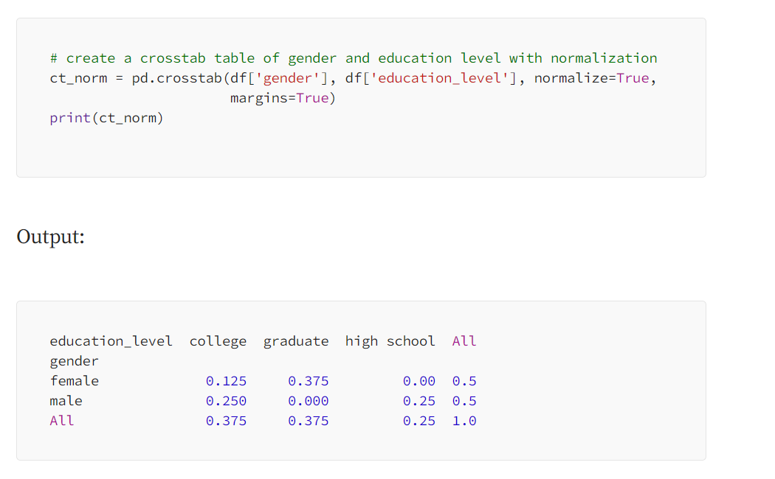
Normalizing Crosstab Table The crosstab() function also allows you to normalize the table by dividing the values by the grand total. This can be useful for comparing the relative frequencies of different combinations of variables.

Slide 30
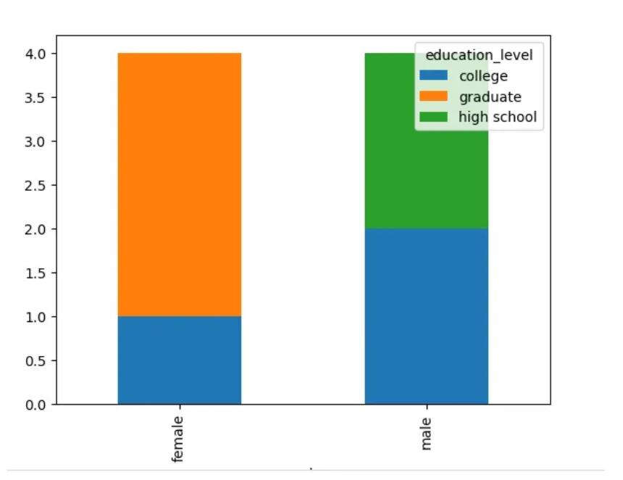
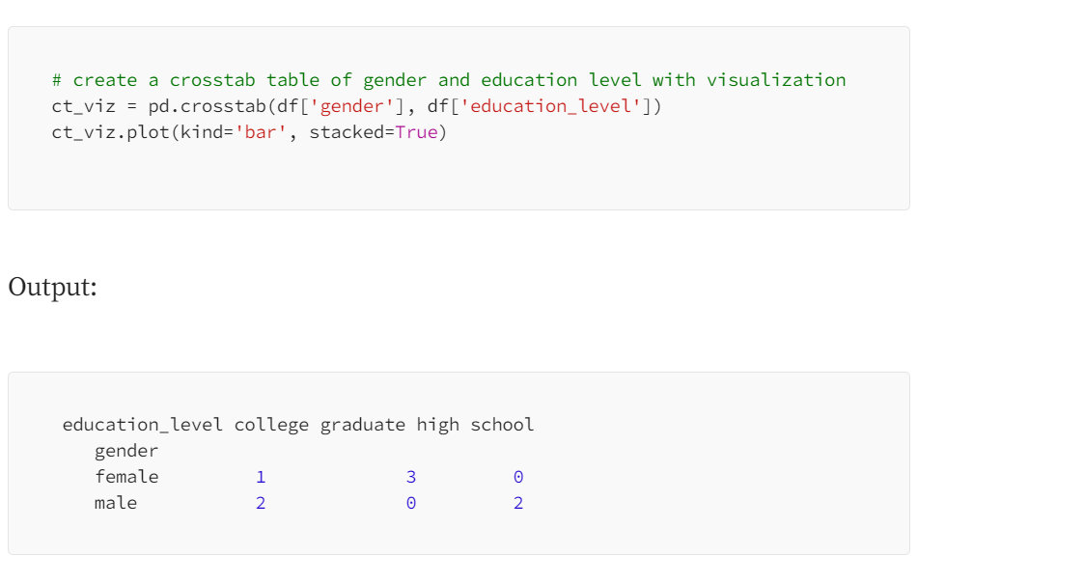
Visualizing Crosstab Table

Slide 31
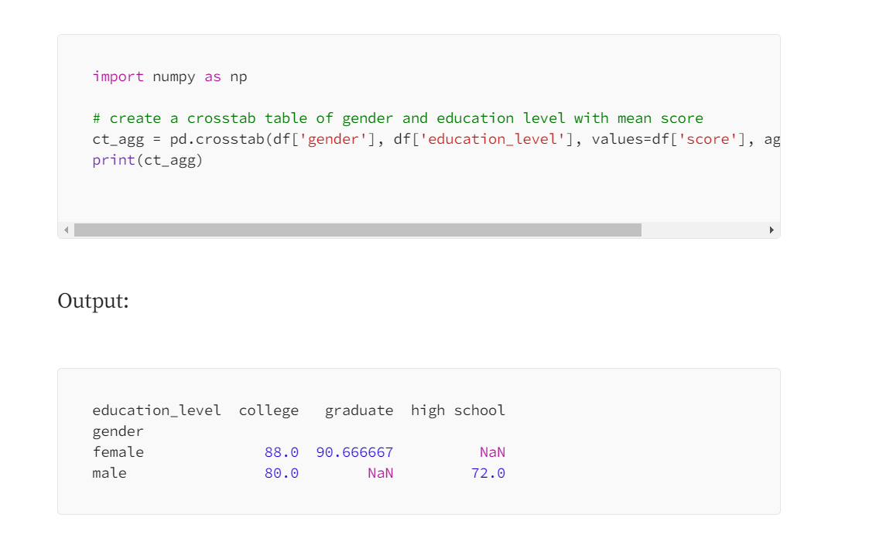
Using Aggregate Function in Crosstab Table

Slide 32
to_datetime()
import pandas as pd
df=pd.DataFrame({'Name':['Alia','Alok','Ravina','Tony'],'DOB':['27-06-1990 09:10:0','15-07-1997 17:34:0',
'05-05-1994 18:30:30','08-07-1995 20:12:0']})
df['DOB']=pd.to_datetime(df['DOB'],dayfirst=True)
df['col']=pd.to_datetime(df['DOB'],dayfirst=True).dt.month_name()
print(df)
df['DOB']=pd.to_datetime(df['DOB']).dt.strftime("%d-%m-%Y")
print(df)
df['month']=df['DOB'].dt.month_name()
df['Day']=df['DOB'].dt.day_name()
print(df)
df['Birth time']=df['DOB'].dt.strftime("%I:%M:%S %p")
print(df)

